Slide 1
Resilient Distributed Datasets: A Fault-­Tolerant Abstraction for In-­Memory Cluster Computing
Matei Zaharia, Mosharaf Chowdhury, Tathagata Das, Ankur Dave, Justin Ma, Murphy McCauley, Michael J. Franklin, Scott Shenker, and Ion Stoica, University of California, Berkeley
nsdi’12

Slide 2
Outline
Motivation
Goal
Design
Evaluation

Slide 3
Motivation
MapReduce greatly simplified “big data” analysis
But as soon as it got popular, users wanted more:
» More complex, multi­‐stage applications
(e.g. iterative machine learning & graph processing)
» More interactive ad-­hoc queries
Lack Efficient primitives for data sharing

Slide 4
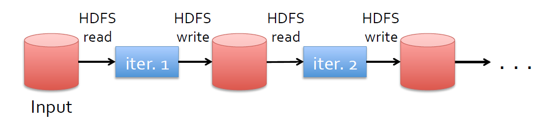





Example

Slide 5
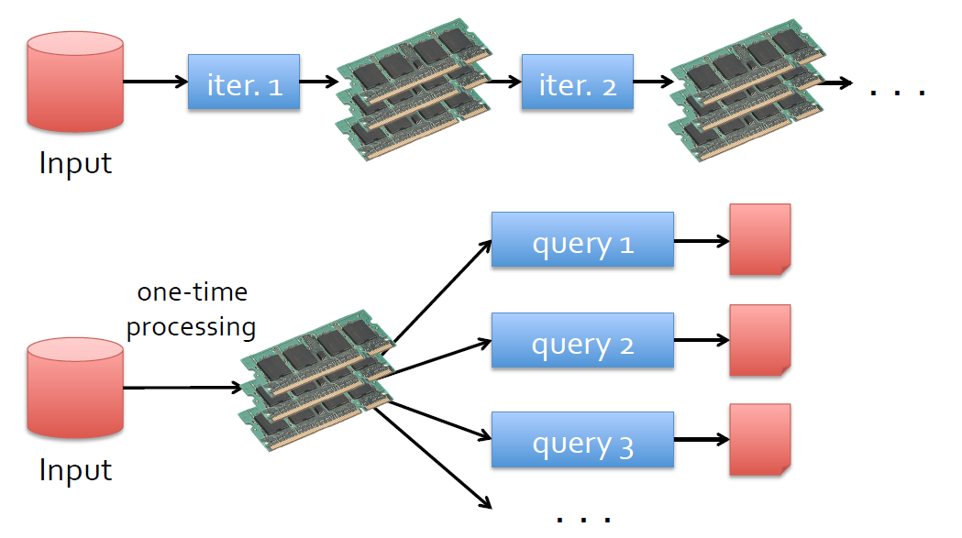
Goal: In-­Memory Data Sharing
General reuse

Slide 6
Design: Resilient Distributed Datasets (RDDs)
Restricted form of distributed shared memory
» Immutable, partitioned collections of records
» Can only be built through coarse-­grained deterministic transformations(map, filter, join,…)
Comparison of RDDs with DSM

Slide 7
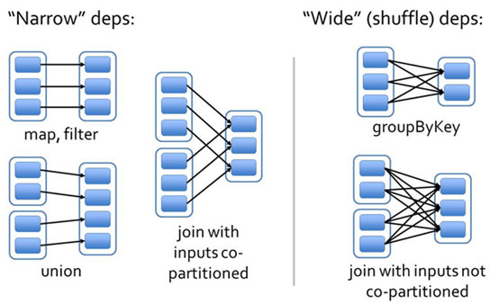
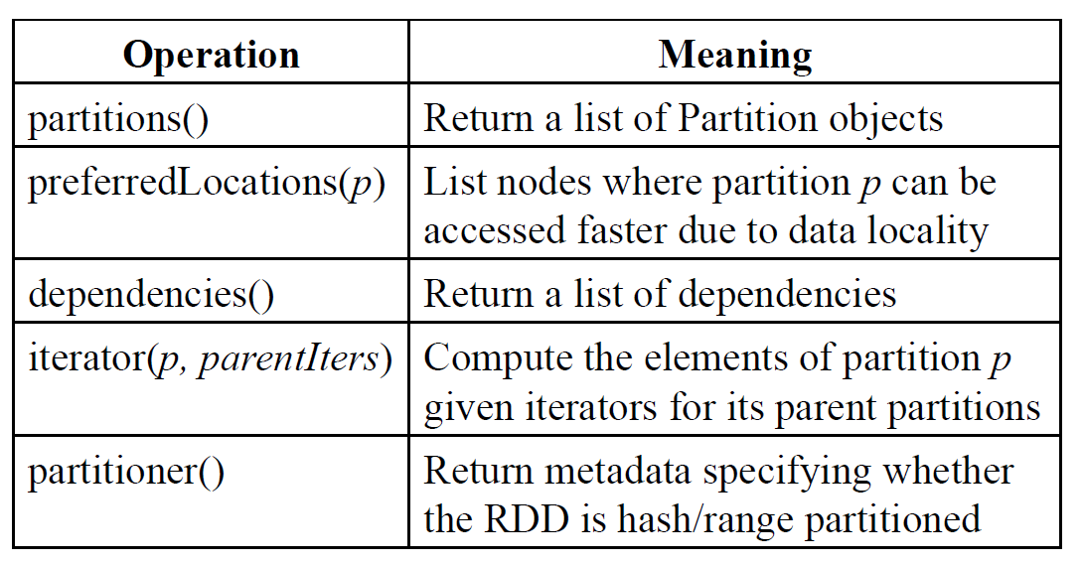
RDDs Interface

Slide 8
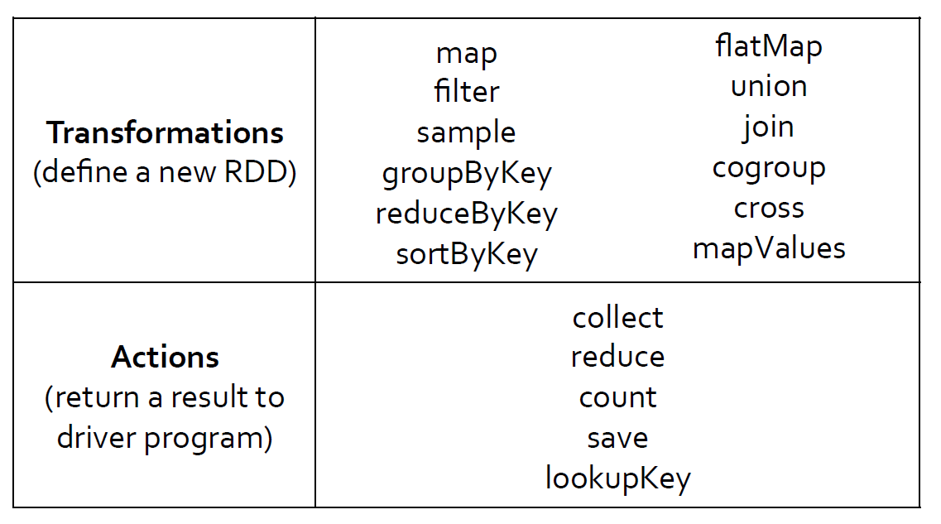
Spark Operations
Persist/cache

Slide 9
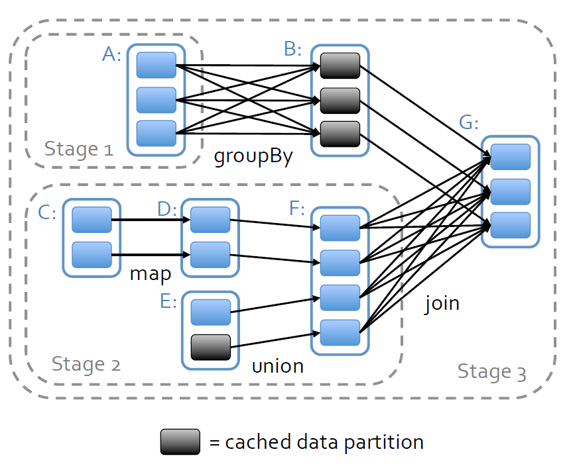
Job Scheduling

Slide 10
Fault Recovery
lineage: track the graph of transformations that built them To rebuild lost data
checkpoint: support for checkpointing

Slide 12
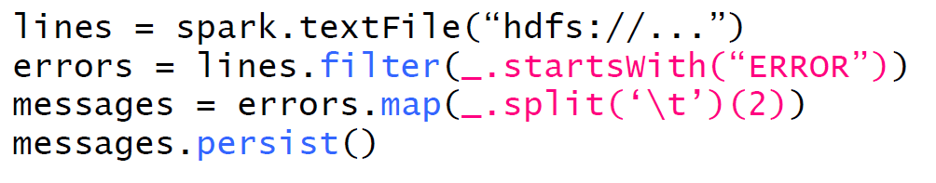
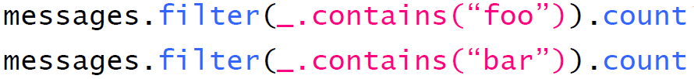
Example: Log Mining
Load error messages from a log into memory, then interactively search for various patterns

Slide 13
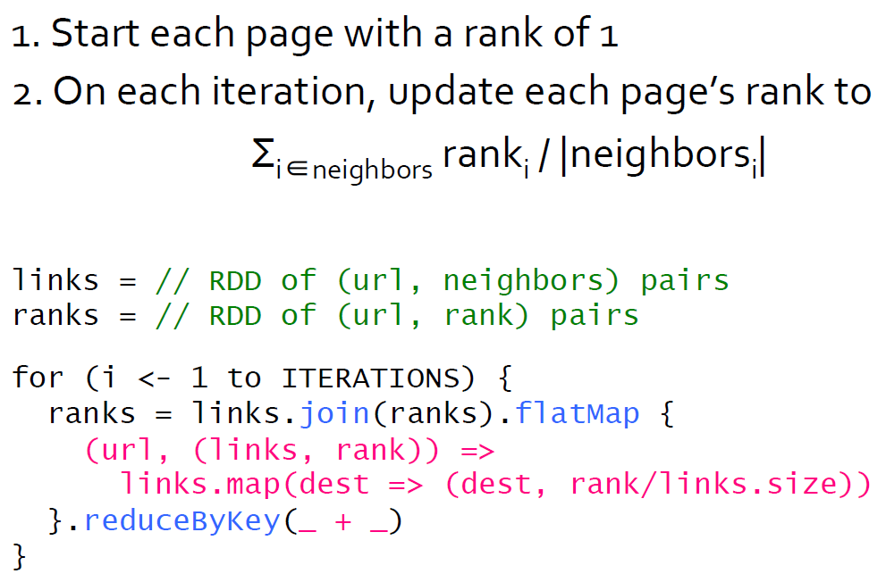
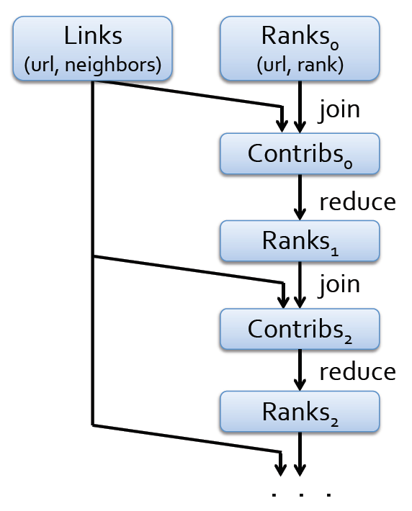
Example: PageRank

Slide 14
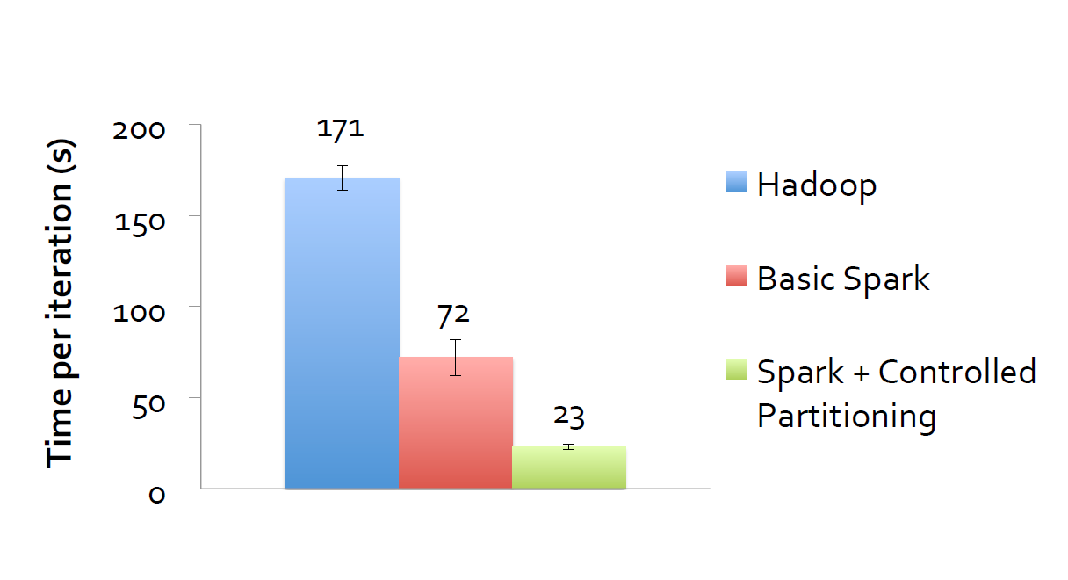
Evaluation

Slide 15
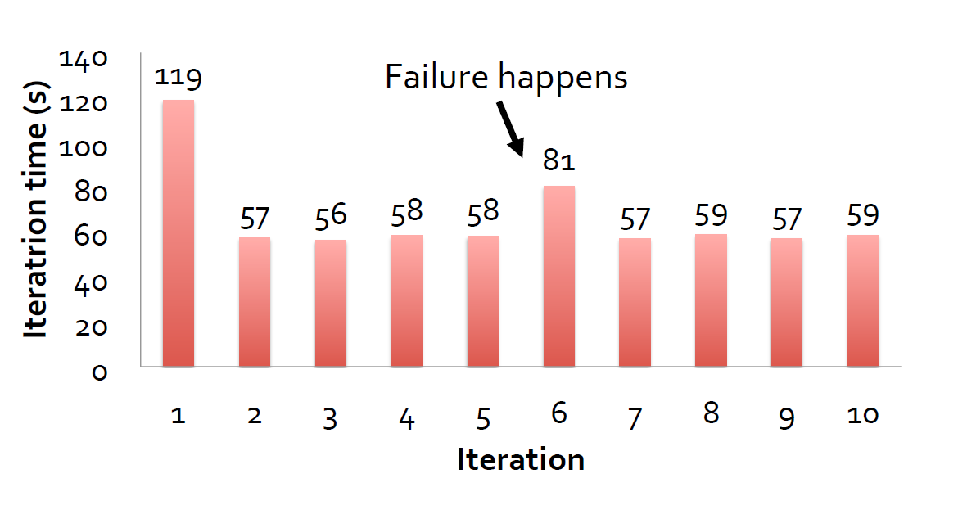
Evaluation

Slide 16
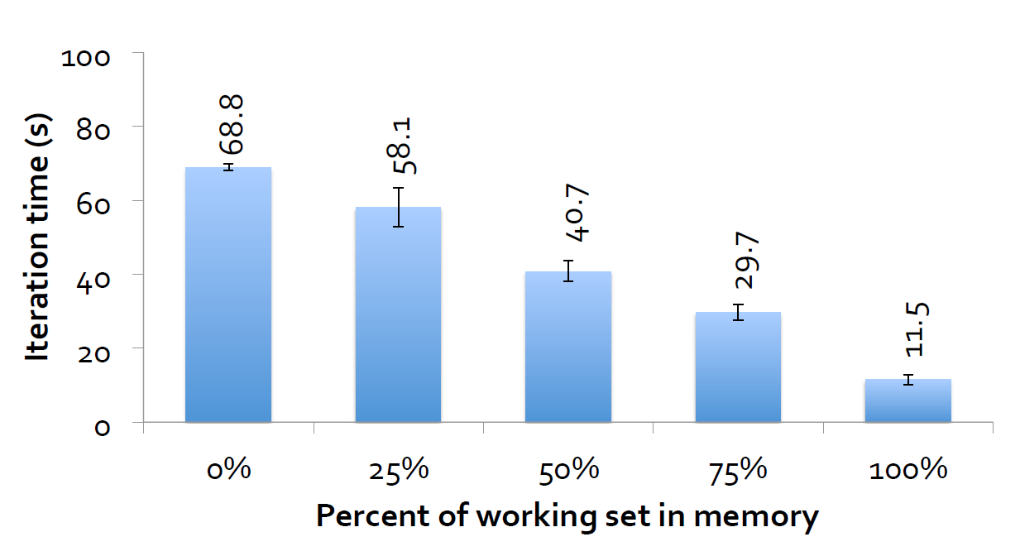
Evaluation

Slide 17
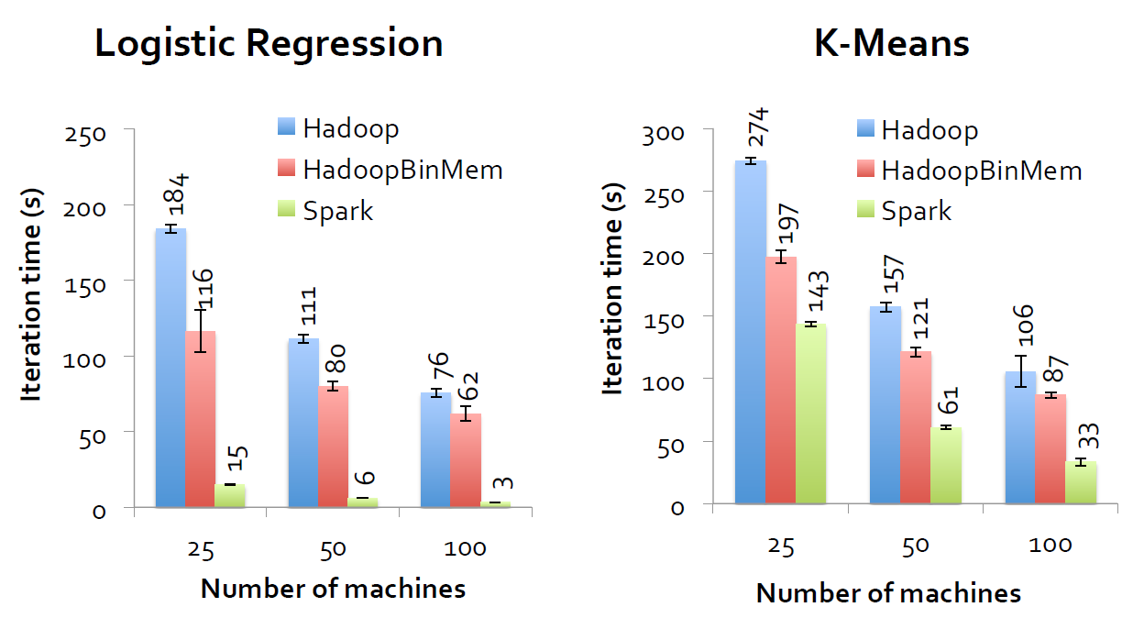
Evaluation

Slide 18

Thanks
Q&A

